Slide 1
Recitation 4

Slide 2
Info
Jon Rutkauskas
Recitation: Tue 12-12:50
Office Hours: Tue 11-11:50 Thur 11-12:50 SENSQ 5806 (additional hours by appointment if needed)
On discord: @jrutkauskas
By email: jsr68@pitt.edu
Github: https://github.com/jrutkauskas/spring2019-449-rec
Ask me any questions you have!!!

Slide 3
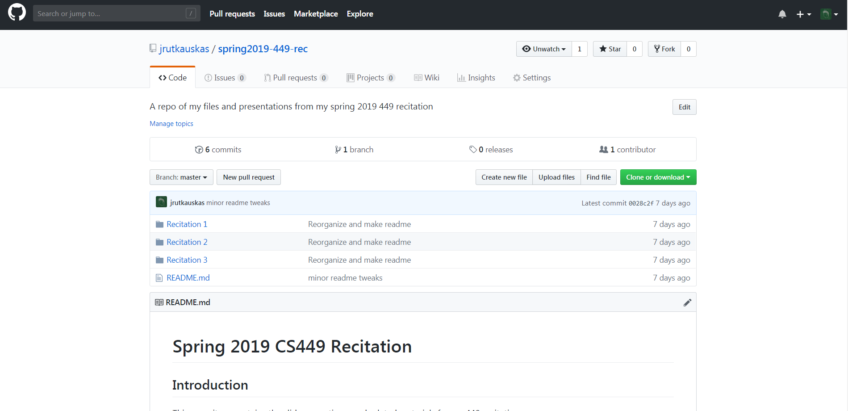
New: Github!
https://github.com/jrutkauskas/spring2019-449-rec

Slide 4
Warmup Polls
https://www.polleverywhere.com/my/polls

Slide 5
If you Forget to free memory that was malloc’d, what happens?

Slide 6
If you Forget to free memory that was malloc’d, what happens?
The memory is used until the program ends
It doesn’t matter if all pointers to it go out of scope, we don’t have a Garbage Collector ☹
Until we call free on it, it stays reserved, and takes up space on the heap.
Once the program ends, ALL memory it used is released back to the system
Including memory leaks.

Slide 7
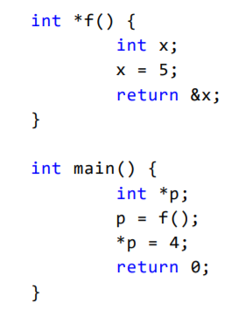
What’s wrong with this code?

Slide 8
What’s wrong with this code?
X is created in the function f
It exists in f’s Activation Record
When f returns, that activation record is popped off
All of its memory is now ‘inaccessible’
Not really, you shouldn’t access it, the system could give it to someone else
It could be garbage, it could segfault, it could do anything… don’t do it!

Slide 9
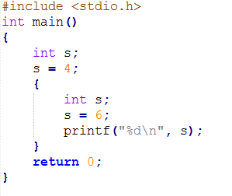
What Happens when this code is run?

Slide 10
What Happens when this code is run?
6 is printed!
The scope of that second ‘s’ variable is limited to the inside of those curly braces
You set it to 6 in there
Then it’s printed.
This wacky nonsense is valid C… but ugly and hard to read and you shouldn’t do it

Slide 11
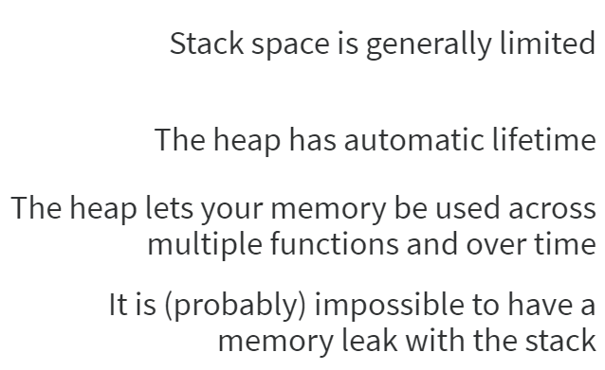
What is not true of the Heap?

Slide 12
Answer
Stack space is quite limited – 10MB on thoth (FOR ALL FUNCTIONS TOGETHER)
The heap does not have automatic lifetime. Memory allocated here must be manually free’d when you’re done
Which is useful because this memory can be used across multiple functions and all over the place until it is manually free’d. So no need to worry about if it goes out of scope as long as you don’t lose your last pointer to the memory.
Stack memory cannot leak. It DOES have automatic lifetime, and will be released at the end of the function.

Slide 13
Other Questions

